Slide 1
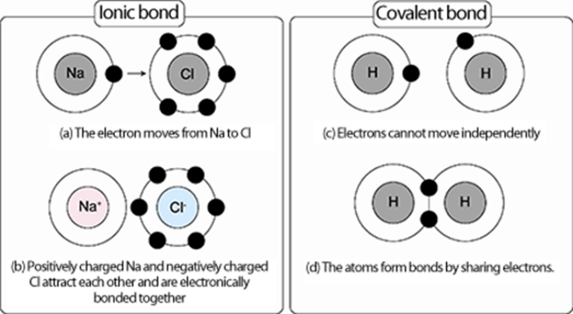
Atoms and Chemical Bonding

Slide 2

Elements and Chemical Bonds
What can an atom’s position on the periodic table tell you about its ability to chemically bond?
Why do atoms gain, lose, or share electrons?

Slide 3
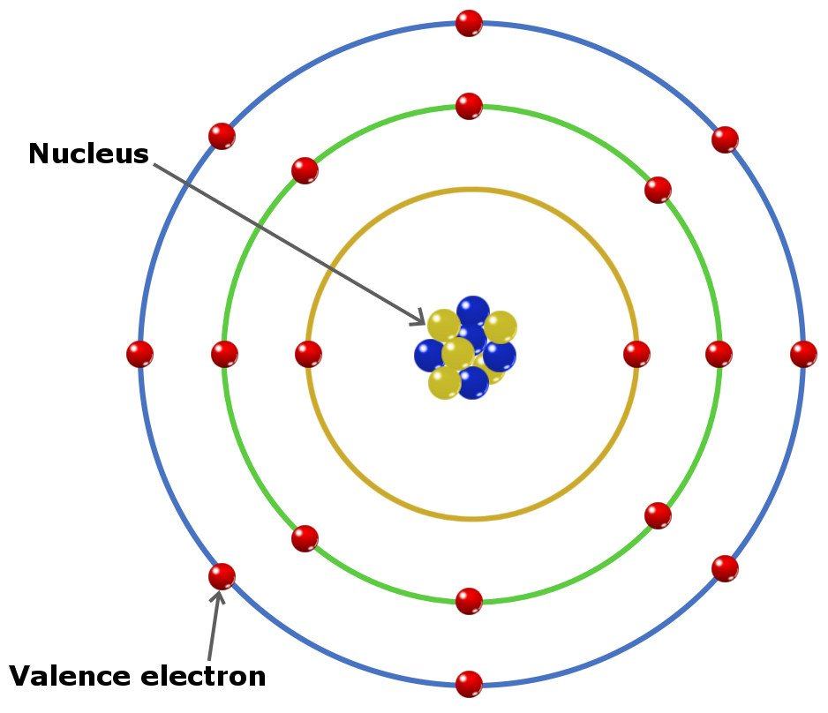
Elements and Chemical Bonds
Why do atoms chemically bond to form compounds?
  Most of the matter around you is made of compounds.
  A chemical bond is a force that holds two or more atoms together in a compound.
  A valence electron is an outermost electron of an atom that participates in chemical bonding.

Slide 4
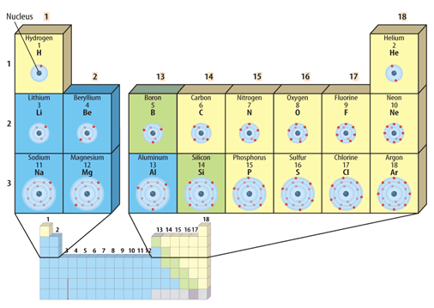
Elements and Chemical Bonds
The number of valence electrons in each atom of an element can help you tell the type and number of bonds that an atom can form.
The periodic table can tell you how many valence electrons an atom has.

Slide 5

Elements and Chemical Bonds
Elements in the same group/family have the same number of valence electrons.
Valence electrons determine stability.
Octet rule
<8 = unstable
8 = stable

Slide 6
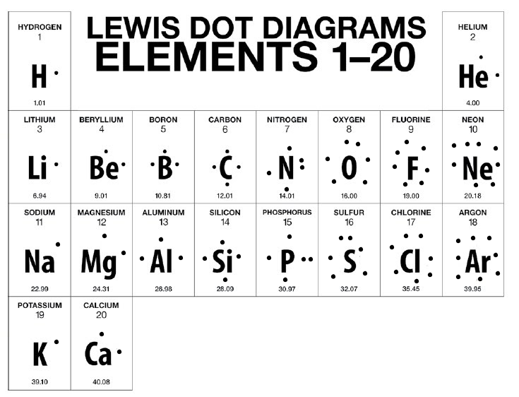
Elements and Chemical Bonds
Electron Dot Diagrams are a model that represents valence electrons in an atom as dots around the element’s chemical symbol.

Slide 7
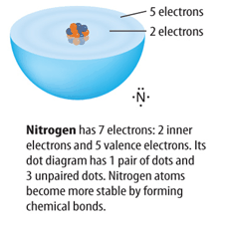
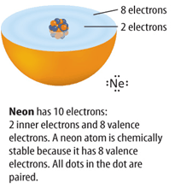
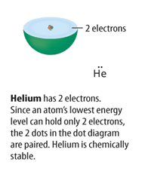
Elements and Chemical Bonds
Atoms gain, lose, or share valence electrons (to get 8 in outer energy level) and become chemically stable.
Atoms can become stable in 2 ways: By transferring electrons - ionic bond By sharing electrons - covalent bond

Slide 8
Elements and Chemical Bonds
How do atoms form an ionic bond?
What kind of compound is formed from an ionic bond?
What are some characteristics of an ionic compound?

Slide 9
Elements and Chemical Bonds
How do atoms form an ionic bond?
Ionic bonds involve a transfer of valence electrons
One atom will give up valence electrons, one atom will take valence electrons

Slide 10

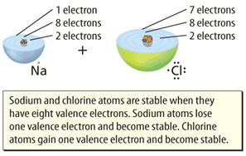
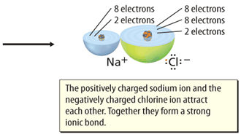
Elements and Chemical Bonds
An ionic bond forms between Na and Cl when an Na atom transfers an electron to a Cl atom.
An ion is an atom that is no longer electrically neutral because it has lost or gained valence electrons.

Slide 11
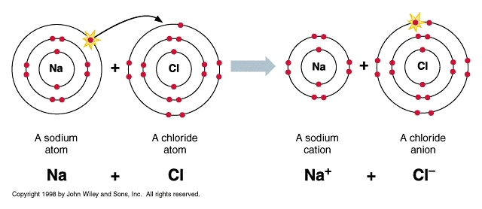
Elements and Chemical Bonds
Atoms are electrically neutral because they have the same number of protons and electrons.
Once an atom gains or loses electrons, it becomes a charged ion.
Ionic Bonds stay together because the charges of the ions are attracted to each other.

Slide 12
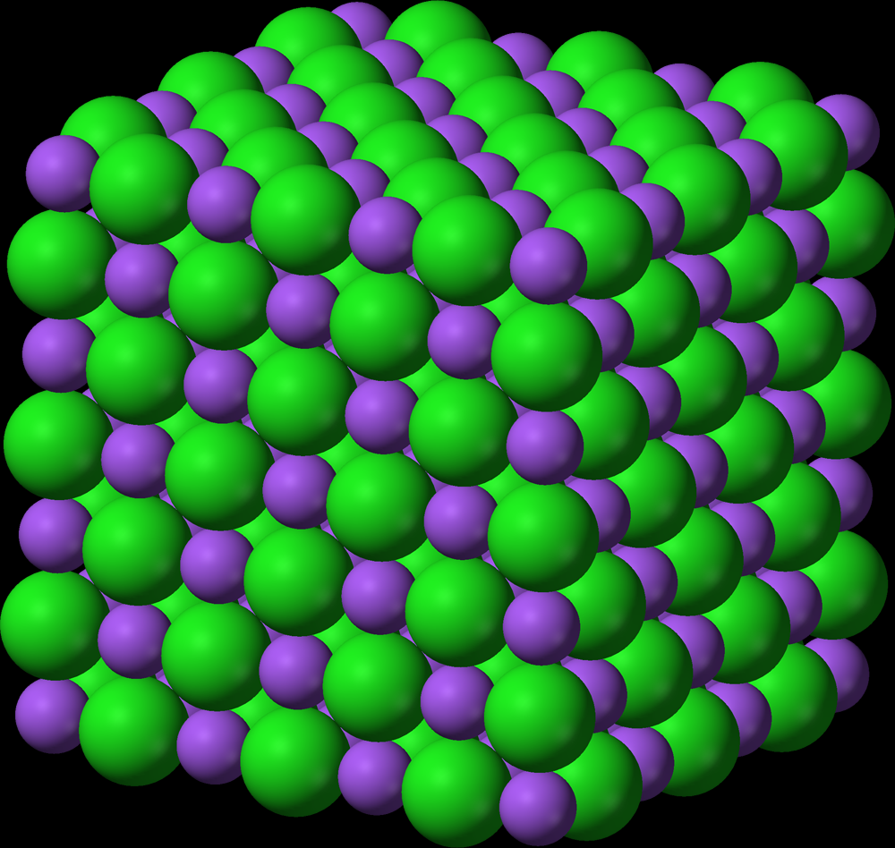
Elements and Chemical Bonds
Characteristics of an Ionic Bonds: involve transfer of electrons forms ions (atoms with a charge) between metals and nonmetals forms ionic compounds

Slide 13
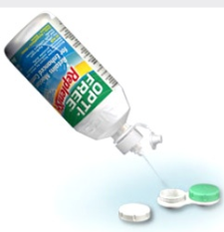
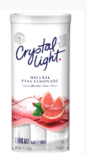
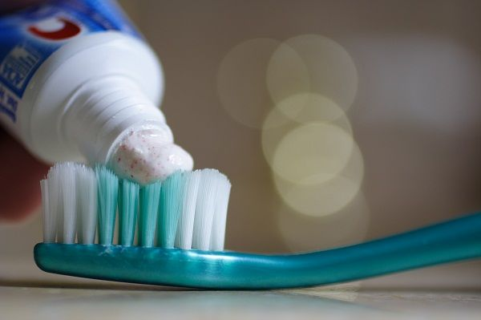
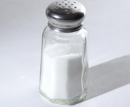
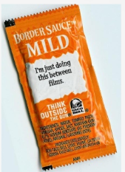
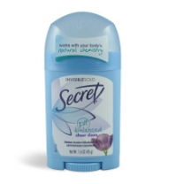
Elements and Chemical Bonds
Ionic Compounds Characteristics: Brittle solids with crystal shapes Good insulators in solid form, but become good conductors in liquid or dissolved form High melting and boiling point

Slide 14
Elements and Chemical Bonds
How do atoms form an covalent bond?
What kind of compound is formed from an covalent bond?
What are some characteristics of an covlent compound?

Slide 15
Elements and Chemical Bonds
How do atoms form a covalent bond?
Covalent bonds involve a sharing of valence electrons
Atoms can share 1 pair, 2 pairs, or 3 pairs of valence electrons.

Slide 16
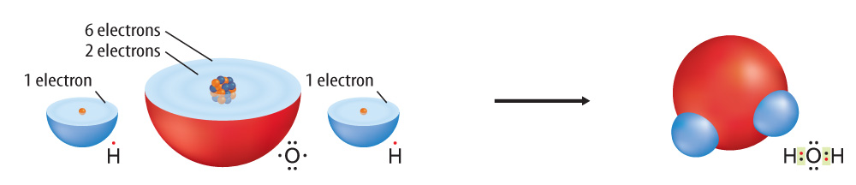
Elements and Chemical Bonds
An covalent bond forms between H and O when an two H atoms each share an electron with an O atom.
Covalent bonds stay together in a molecule.

Slide 17
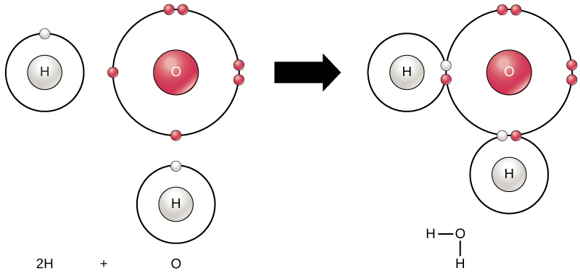
Elements and Chemical Bonds
An covalent bond forms between H and O when an two H atoms each share an electron with an O atom.
Covalent bonds stay together in a molecule.

Slide 18
Elements and Chemical Bonds
Covalent Bonds: involve sharing of electrons no ions formed (atoms with a charge) between nonmetals and nonmetals forms covalent compounds (molecules)

Slide 19

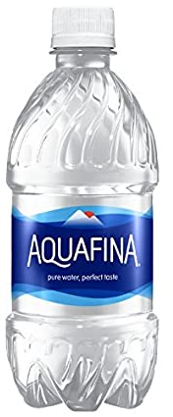
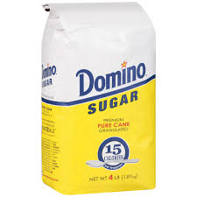


Elements and Chemical Bonds
Covalent Compounds Characteristics: Soft solids Good insulators in solid form Do not conduct electricity in water Low melting and boiling point

